Slide 1



BDAT-1000 Data Manipulation Techniques Group Assignment
Sharon(Hsiang-Chun Shepherd) – 200520387
Shivansh Setia – 200511522
Isha Gupta – 200507041
Harshdeep Singh Maggo - 200480837

Slide 2

Amazon Top 50 Bestselling Books 2009 – 2019

Slide 3
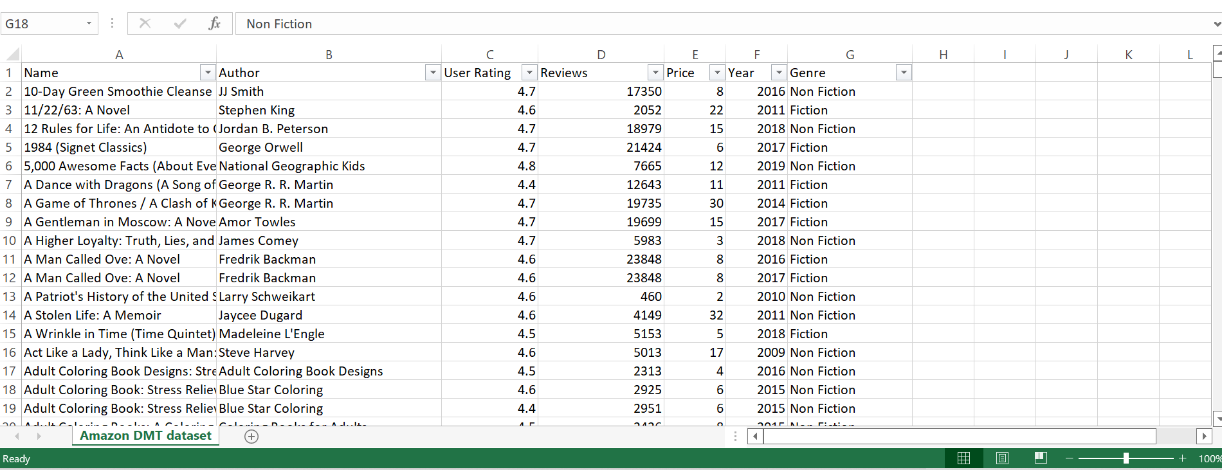
INTRODUCTION TO DATASET

Slide 4
Our dataset is about Amazon's Top 50 bestselling books from 2009 to 2019. This data set includes seven categories as described below: NAME - Name of the Book AUTHOR - The creator or originator of a book USER RATING – Amazon customer rating REVIEWS- Number of written reviews on amazon PRICE- The price of the book YEAR - The Year(s) it ranked on the bestseller GENRE - Whether fiction or non-fiction.

Slide 5
WHY DID WE SELECT THIS DATASET?
Our team has decided to go with this dataset because:
Interesting for analysis.
Mix of qualitative and quantitative variables.
7 variables, 550 rows.
No additional cleaning required.
A variety of data types –
Year(Time)
Ratings(Decimal)
Name(String)
Genre(Categorical)
--- Great for analysis and visualization on a beginner level.

Slide 6

Top 10 most reviewed books

Slide 7
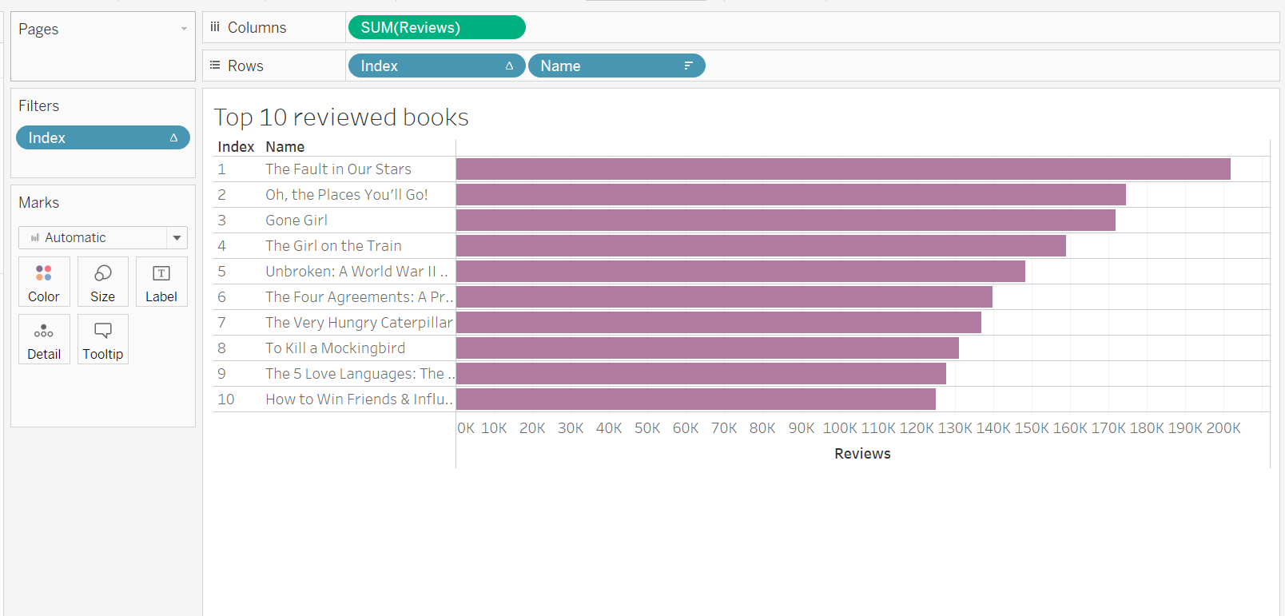
(most controversial books)

Slide 8
Preferred genre among bestsellers

Slide 9
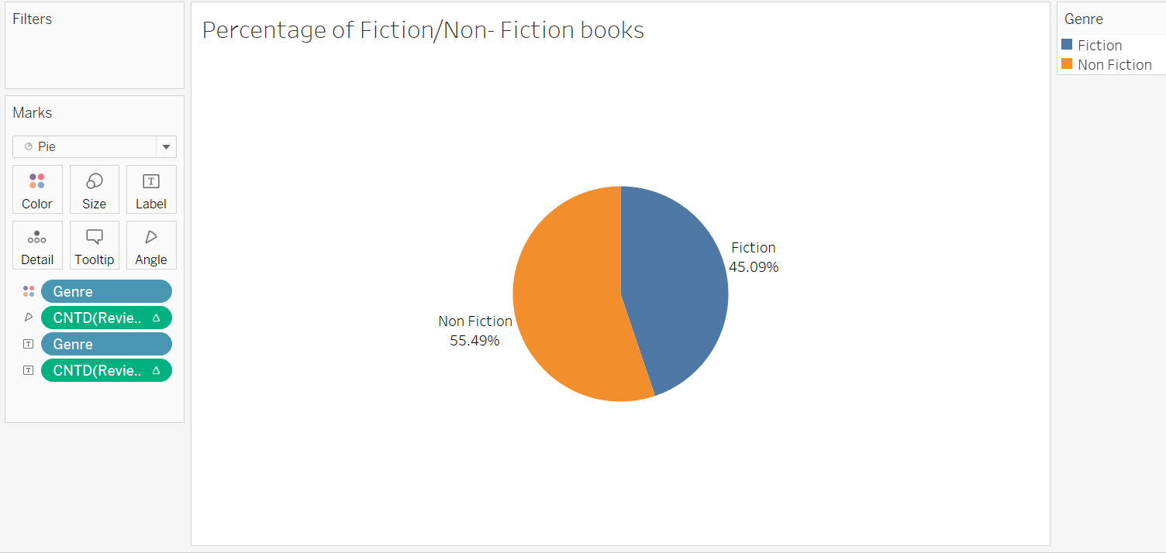
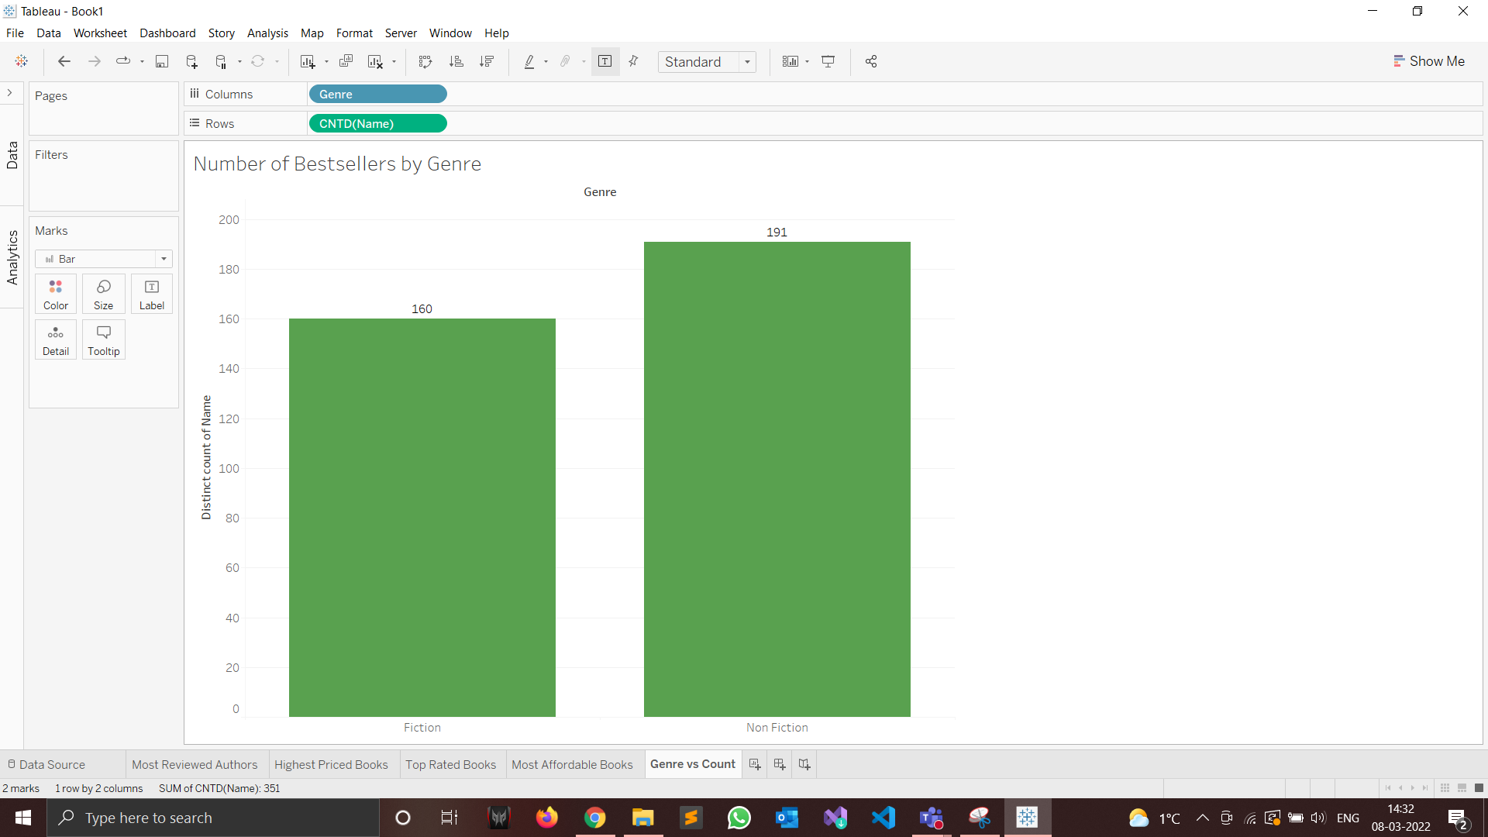
with most reviews

Slide 10


10 most loved authors based on user rating

Slide 11
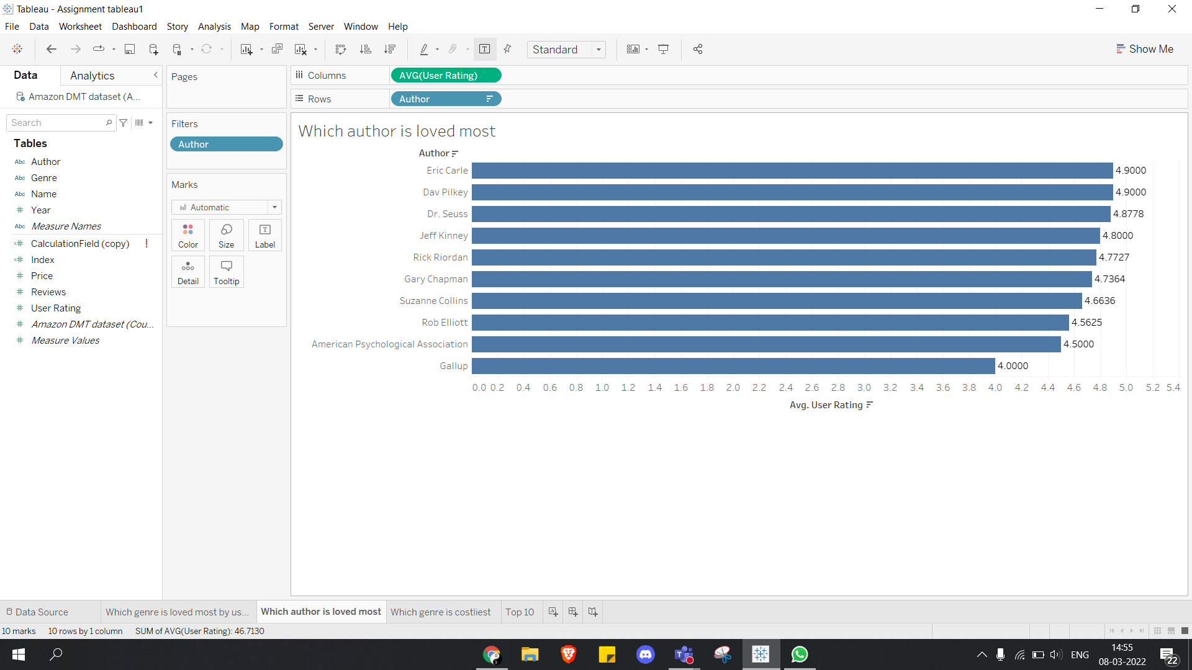
(Children’s Fiction:
”The Very Hungry Caterpillar”)
(Children’s Fiction:)
(N-Fic: “The 5 Love Languages”)
(Fiction: “The Hunger Games”)
(N-Fic: APA Citation Guide)

Slide 12

5 most reviewed authors?

Slide 13
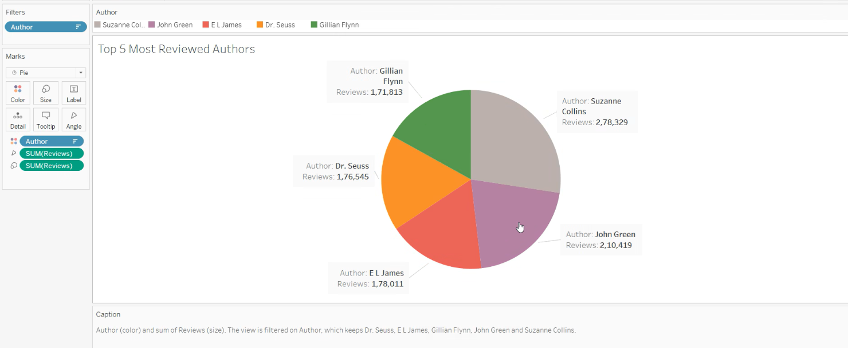
(Most controversial Authors)
(Fiction: “Gone Girl”)
(Fiction: “The Hunger Games”)
(Children’s Books)
(Fiction: “The Fault in Our Stars”)
(Fiction: “50 Shades of Grey”)

Slide 14

10 most expensive bestsellers?

Slide 15
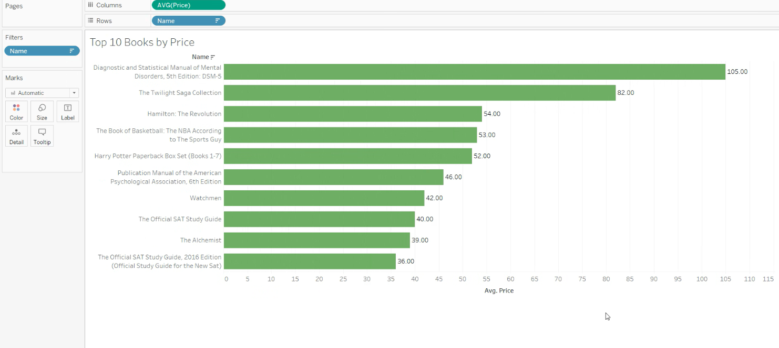

Slide 16

10 highest-rated bestsellers?

Slide 17
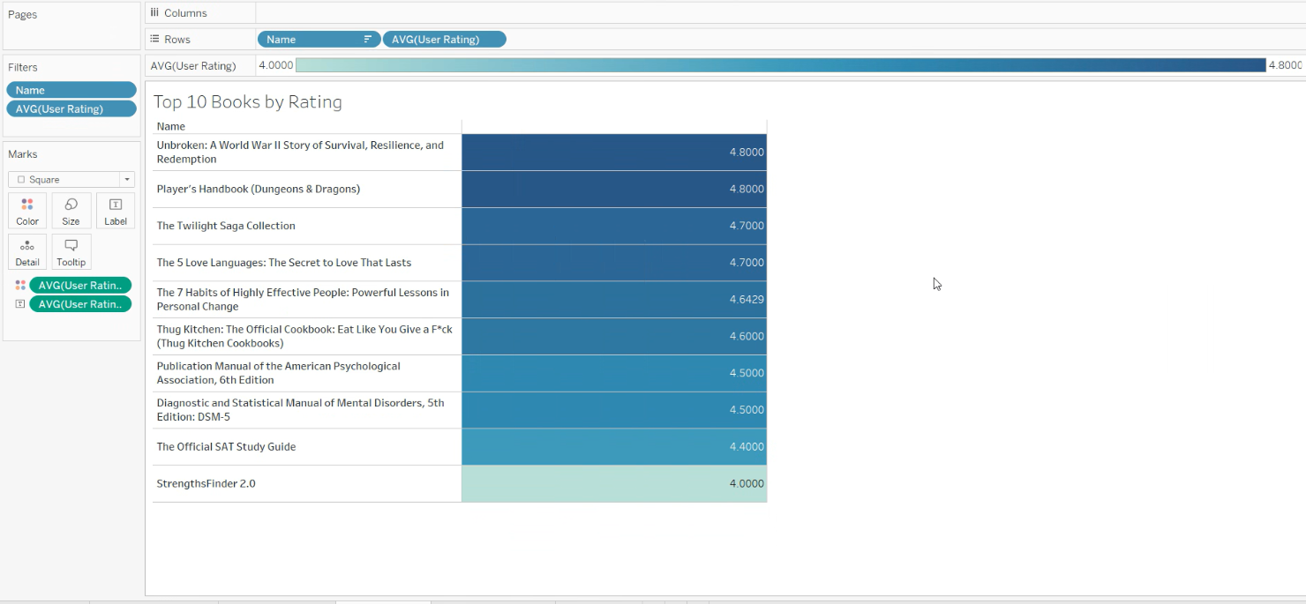

Slide 18



10 most affordable books?

Slide 19
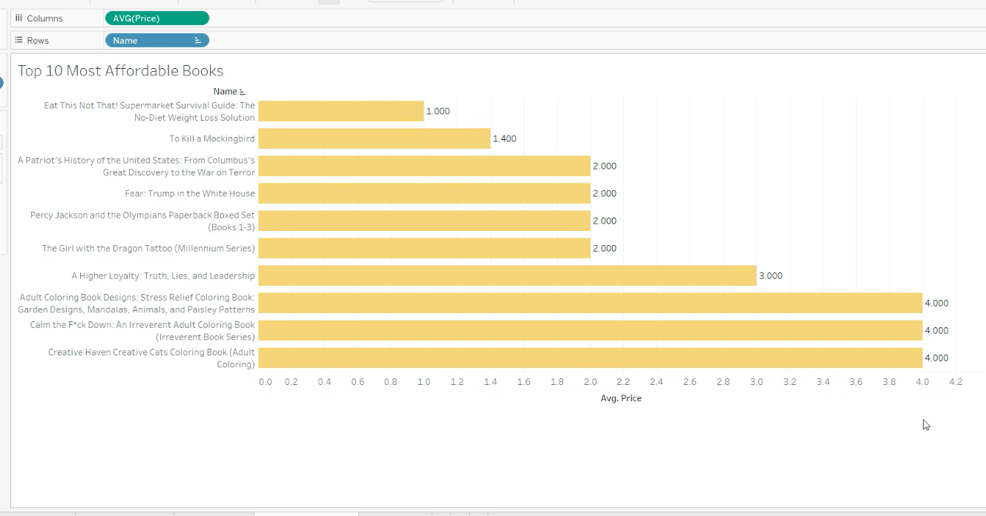
Notice: These are the most popular books
IE. Supply & Demand

Slide 20


Reference
Saalu, Sooter. (2020 October 13). Amazon Top 50 Bestselling Books 2009 - 2019: Scrapped dataset on October 2020, categories (fiction/non-fiction) added. https://www.kaggle.com/sootersaalu/amazon-top-50-bestselling-books-2009-2019

